Slide 1

CryptoBot with Binance
Using ARIMA Model with Daily and Weekly Updates
Data Engineering Final Project
Charles AWAD
Houssein YASSINE
Rachad JABBOUR
Notes:
Ahmad

Slide 2
Section Break
Introduction
Notes:
houssein

Slide 3
Introduction
The goal of this project is to accurately predict the price of Bitcoin for the upcoming 7 days.
We achieve this by:
Collecting historical prices data from Binance API
Storing the data in a dedicated database
Daily process:
Fetch the latest Bitcoin prices
Update the database with the new daily prices
Weekly process:
Rerun the prediction model
Generate new forecasts for the next 7 days
Our prediction model utilizes ARIMA for forecasts.
This approach allows us to:
Adapt to the highly volatile nature of cryptocurrency markets
Provide investors with valuable insights and informed decision-making capabilities
Notes:
Houssein

Slide 4




Technologies Used
Database Engine : PostgreSQL
API: FastAPI
Scheduling: Apache Airflow
Containerization: Docker
Notes:
Rachad
Airflow to schedule and orchestrating the project
We used the fast api as a web framework to build api

Slide 5
Section Break
Project Structure
Notes:
AHmad
This part will be diveded into two section first the phisical folder structure , then the logical structur of the project

Slide 6
Folder Structure
Python_code Folder
Scripts:
Create the database and tables
Retrieve and clean historical data from Binance
Add records to the ‘Kline’ table in pg
Includes Docker build file
Fastapi-app Folder
Main file for FastAPI application
Includes Docker build file
Airflow Folder
DAG files for scheduling tasks
Includes Docker build file
Main Folder
‘.env’ file: Binance tokens and database credentials
‘docker-compose.yml’ file
README.m: Technical project details and help
Notes:
Ahmad

Slide 7
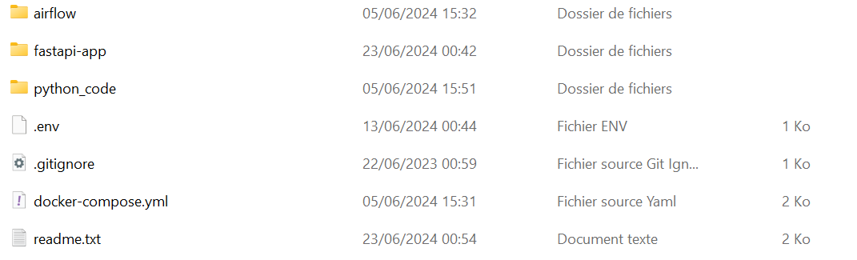
Folder Structure
Notes:
Ahmad

Slide 8

Docker
3 Containers
Python code
Fastapi app
Airflow
Docker compose up
Notes:
Houssein
Docker Image:
the Docker image includes 3 services:
python_code: This service includes Python scripts responsible for the initial setup, such as creating databases, tables, and fetching historical data.
Fastapi: FastAPI operates on port 8000 within the Docker container.
airflow: Airflow operates on port 8080 within the Docker container.

Slide 9
Python code
Python Code
Container to run inital Setup for:
Database Structure
File: ‘Metadata.py’
Task: Initialize database and tables
Fetching Historical Prices
File: ‘binance_historical_data’
Task: Retrieve Bitcoin historical prices (CSV files)
Importing Data to Database
Task: Read, clean, and import historical price records into ‘kline’ table
Creating Initial User
Task: Initialize an initial user in the ‘users’ table for FastAPI authentication
Notes:
Rachad

Slide 10
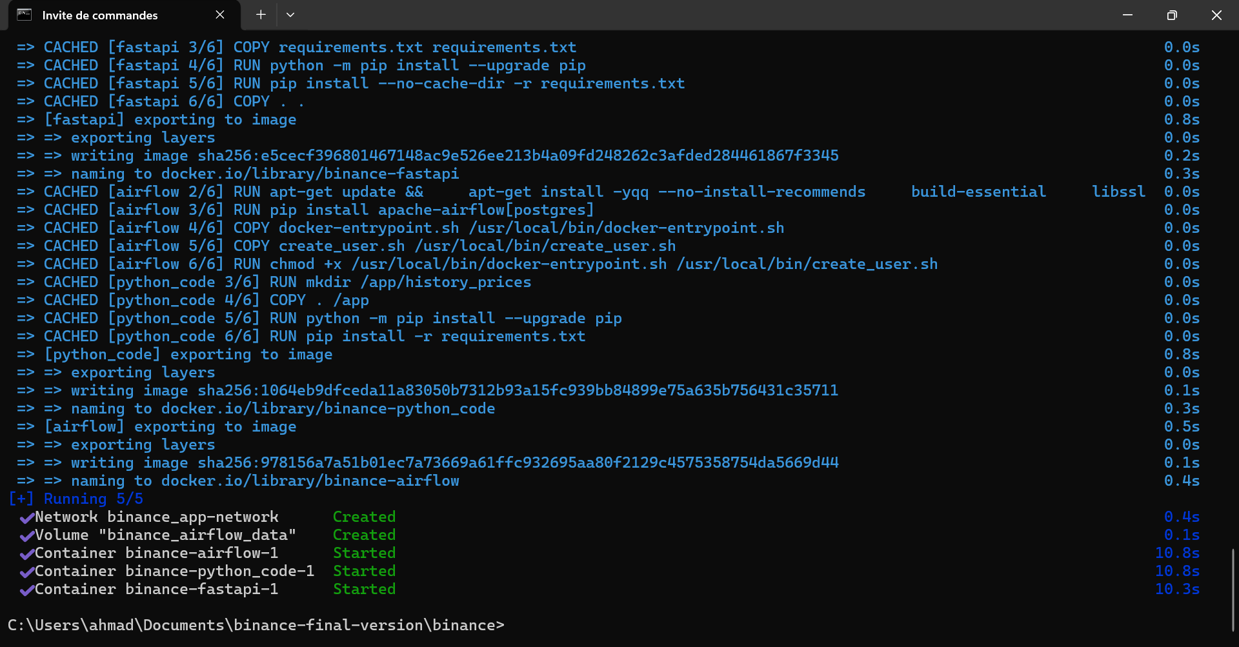
Python code
Python Code
Docker running with cmd:
Notes:
Rachad
The docker up than run firstly the python code

Slide 11
Fastapi app
FastAPI
Fast API operates on port 8000 within the Docker container
User Authentication with JWT
Functionality: Implements JWT for API security
Process: Users log in to obtain a token for subsequent API calls
Fetching Daily Prices from Binance
Function: Retrieves daily prices from Binance
Variable: Date parameter specifies the specific date
ARIMA Prediction Module
Function: Runs ARIMA prediction model
Output: Predicts prices for the next 7 days, stored in the prediction table
Plotting Predicted Results
Function: Implements visualization of predicted
results.Display: Plots predicted prices alongside actual last 7 days' prices
Notes:
Ahmad
Lets talk about the core of our sys
Its in the center of our system tem
*
We can add user and delete user

Slide 12
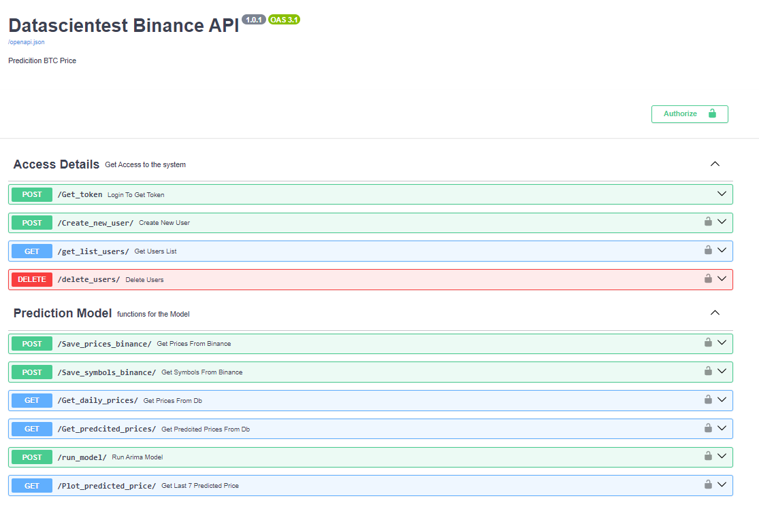
Fastapi app
FastAPI
Notes:
Ahmad

Slide 13

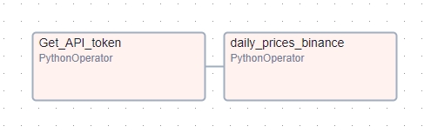
Airflow
Airflow
Airflow operates on port 8080 within the Docker container.
DAG 1: Daily Prices Update
Purpose: Ensures the system always has the latest daily prices from Binance
Task 1: Get API Token
Function: Retrieves JWT token for authentication
Output: Passes token value via Xcom
Task 2: Daily Prices binance
Function: Uses token from Task 1 to fetch daily prices
Dependency: Depends on Task 1 for JWT token
Output: Stores prices for the last day in the database
Notes:
Houssein
Let's discuss the Airflow setup for our project. Apache Airflow is used to schedule and orchestrate our tasks efficiently. We have designed two DAGs to manage our daily and weekly tasks. The first DAG, 'Daily Prices Update,' runs every day to fetch the latest Bitcoin prices from Binance. This ensures our database is always up-to-date with the most recent data. It has two tasks:
Task 1: 'Get Token,' which retrieves the JWT token needed for API authentication. This token is then passed to the next task using XCom.
Task 2: 'Fetch Daily Prices,' which uses the token to authenticate and retrieve the latest daily prices from Binance, storing them in our database.

Slide 14

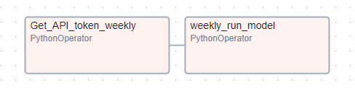
Airflow
Airflow
DAG 2: Weekly Prediction Module
Purpose: Performs weekly predictions using the ARIMA model & focuses on strategic decision-making by forecasting future prices based on historical data.
Task 1: Get Token
Function: Retrieves JWT token for authentication
Output: Passes token value via Xcom
Task 2: Run Prediction ModuleFunction: Executes ARIMA prediction for next 7 days
Dependency: Depends on Task 1 for JWT token
Output: Stores predicted prices in the database
Notes:
Rachad
The second DAG, 'Weekly Prediction Module,' runs every week to perform price predictions for the next 7 days using the ARIMA model. This DAG also has two tasks:
Task 1: 'Get Token,' similar to the daily DAG, retrieves the JWT token for authentication.
Task 2: 'Run Prediction Module,' which uses the ARIMA model to predict future Bitcoin prices and stores these predictions in the database.
By structuring our tasks this way, we ensure a smooth and automated workflow that keeps our data up-to-date and provides regular forecasts. This setup allows us to maintain the accuracy and reliability of our predictions, supporting strategic decision-making."

Slide 15
ARIMA
ARIMA (AutoRegressive Integrated Moving Average) is a time series forecasting method that combines autoregression, differencing, and moving average models
AutoRegressive (AR) Model:
Function: Predicts future values based on past values
Concept: Future values depend linearly on previous observations (autocorrelation)
Integrated (I) Model:
Function: Transforms data into a stationary series through differencing
Purpose: Removes trends or seasonal components from the time series data
Moving Average (MA) Model:
Function: Predicts future values based on past forecast errors
Approach: Uses the linear combination of past errors (difference between observed and predicted values).
ARIMA Notation: ARIMA(p, d, q)
p: Number of lag observations included in the model (AR order)
d: Number of times raw observations are differenced (integration order)
q: Size of the moving average window (MA order)
Notes:
Ahmad
The brain of our system
AutoRegressive (AR) Component
Explanation:
(p = 5):
Uses five lagged observations to predict future values.
Assumes future values depend linearly on the five most recent observations.
2. Integrated (I) Component
Explanation:
(d = 1):
Applies first-order differencing to the raw observations.
Transforms the time series data to achieve stationarity by subtracting the previous observation from the current one.
3. Moving Average (MA) Component):
Explanation:
(q = 0)
Does not use moving average component.
Predicts future values based solely on the linear combination of past observations and the effects of differencing.
The chosen parameters (p = 5, d = 1, q = 0) indicate that the model uses five lagged observations, applies first-order differencing, and does not incorporate moving average components.
Application:
Effective for time series data that exhibits significant autocorrelation over multiple lagged observations and requires differencing to achieve stationarity.

Slide 16
What we can do next
DASH
Add Dash plot to the project
Give desision directly
Buy or Sell without showing prices
Link the bot to an app
Notes:
Ahmad

Slide 17
We would like show you now our bot
Notes:
Rachad
Presentation of the code : Houssein Then Ahmad
Show : cmd and just speak that the code is running
Show : docker prog / containers / volumes / images
Show : fast api + plot pic + show the plot pic
Show airflow

Slide 18
THANK YOU
Notes:
Thank you for your attention , we will let you ask us

